Slide 1

Portfolio with Deep Learning
Rick Shen
10/8/2024

Slide 2

Problems
Portfolio optimization is a formal mathematical approach to making investment decisions across a collection of financial instruments or assets
Modern portfolio theory involves categorizing the investment universe based on risk and return
Then choosing the mix of investments that achieve a desired goal
Traditional methods use simplistic linear factor models, which does not reflect the complex and nonlinear nature of the financial world
The paper explored a deep learning technique named autoencoder by experimenting on the weekly stock returns from the IBB index (83 biotech symbols) from 2012 to 2016
2
Notes:
https://www.mathworks.com/discovery/portfolio-optimization.html
Heaton et.al., Appl. Stochastic Models Bus. Ind. 2017, 33 3–12
Actual code and data from Derek Snow
https://drive.google.com/drive/folders/1-hOEAiJqaNTUYIyamj26ZvHJNZq9XV09

Slide 3

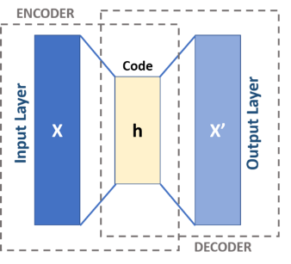


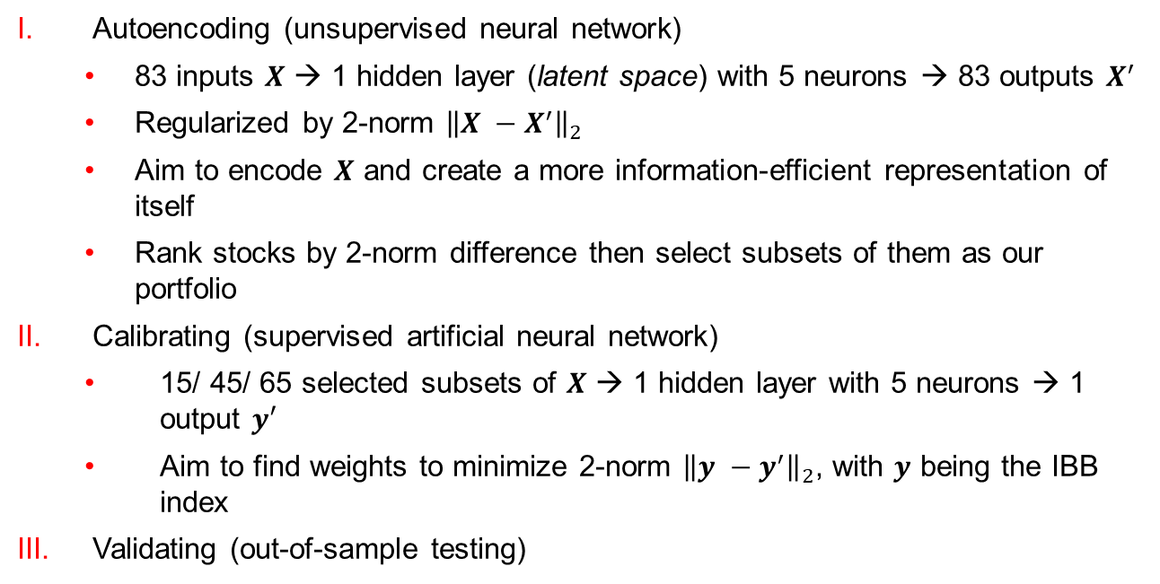
Model
Autoencoding (unsupervised neural network)
83 inputs $X$ → 1 hidden layer (latent space) with 5 neurons → 83 outputs $X^{′}$
Regularized by 2-norm ${\left\|X −X^{′}\right\|}_{2}$
Aim to encode $X$ and create a more information-efficient representation of itself
Rank stocks by 2-norm difference then select subsets of them as our portfolio
Calibrating (supervised artificial neural network)
15/ 45/ 65 selected subsets of $X$ → 1 hidden layer with 5 neurons → 1 output $y′$
Aim to find weights to minimize 2-norm ${\left\|y −y^{′}\right\|}_{2}$, with $y$ being the IBB index
Validating (out-of-sample testing)
Notes:
https://en.wikipedia.org/wiki/Autoencoder
Calibrate – weekly returns of all 83 from 01/2012 – 12/2013
Validate –subsets from 01/2012 – 12/2013

Slide 4
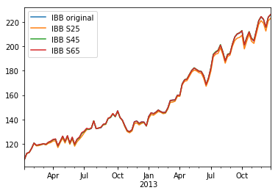
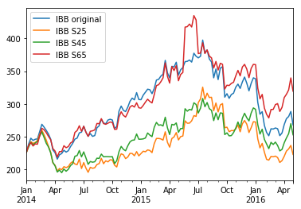
Results
In-sample testing
Out-of-sample testing
Notes:
Portfolio was chosen by top 10 stocks whose 2-norm was the smallest, plus (s-10) of the bottom ones, s = 25, 45, 65
Out-of-sample testing includes the “2015-2016 market selloff” period.
https://en.wikipedia.org/wiki/2015%E2%80%932016_stock_market_selloff

Slide 5
Assessments
The ReLU activation function introduces nonlinearity to the Autoencoder model
It can be interpreted as compositions of put and call options
The abstract features in the latent space can then be thought of as “deep portfolios”
Autoencoder vs. Principal Component Analysis (PCA) –dimension reduction techniques
Nonlinear
Less interpretable
Better flexibility (number of layers/ neurons, supervised capable)
Can be used as target for other supervised learning techniques
Comparison of the same experiment done with PCA can be revealing
Author used top 10 stocks combined with the bottom (s-10), with s = 25, 45, 65, in terms of 2-norm differences from Autoencoder, to construct the portfolios
What if only the top ones are used?
Notes:
https://medium.com/@etorezone/differences-between-autoencoders-and-principal-component-analysis-pca-in-dimensionality-reduction-ca5f24364054
An Autoencoder model was trained to compress weekly returns of 83 stocks between 2012 to 2013 to reconstruct the data itself
Based on the model output, subsets of the stock index were selected
With the selected subsets, a separate 2-layer ANN model was constructed to match the stock index

Slide 6


Slide 7
Backup Slide – Autoencoder Code
encoding_dim = 5 # 5 neurons
num_stock = len(stock_lp.columns) # Use 83 stocks as features
# connect all layers
input_img = Input(shape=(num_stock, ))
encoded = Dense(encoding_dim, activation='relu', kernel_regularizer=regularizers.l2(0.01))(input_img)
decoded = Dense(num_stock, activation= 'linear', kernel_regularizer=regularizers.l2(0.01))(encoded) # see 'Stacked Auto-Encoders' in paper
# construct and compile AE model
autoencoder = Model(input_img, decoded)
autoencoder.compile(optimizer='sgd', loss='mean_squared_error')
# train autoencoder on weekly stock price changes
data = stock['calibrate']['net']
autoencoder.fit(data, data, shuffle=False, epochs=500, batch_size = 10)
autoencoder.save('output/retrack_autoencoder.h5')
# test/reconstruct market information matrix
reconstruct = autoencoder.predict(data)

Slide 8
Backup Slide – ANN Calibration Code
ibb_predict = defaultdict(defaultdict)
total_2_norm_diff = defaultdict(defaultdict)
dl_scaler = defaultdict(StandardScaler)
for non_communal in [15, 35, 55]:
# some numerical values
encoding_dim = 5
s = 10 + non_communal
stock_index = np.concatenate((ranking[0:10], ranking[-non_communal:])) # portfolio index
# connect all layers
input_img = Input(shape=(s,))
encoded = Dense(encoding_dim, activation='relu', kernel_regularizer=regularizers.l2(0.01))(input_img)
decoded = Dense(1, activation= 'linear', kernel_regularizer=regularizers.l2(0.01))(encoded)
# construct and compile deep learning routine
deep_learner = Model(input_img, decoded)
deep_learner.compile(optimizer='sgd', loss='mean_squared_error')
x = stock['calibrate']['percentage'].iloc[:, stock_index]
y = ibb['calibrate']['percentage']
dl_scaler[s] = StandardScaler() # Multi-layer Perceptron is sensitive to feature scaling, so it is highly recommended to scale your data
dl_scaler[s].fit(x)
x = dl_scaler[s].transform(x)
deep_learner.fit(x, y, shuffle=False, epochs=500, batch_size = 10) # fit the model
deep_learner.save('output/retrack_s' + str(s) + '.h5') # for validation phase use
# is it good?
relative_percentage = copy.deepcopy(deep_learner.predict(x))
relative_percentage[0] = 0
relative_percentage = (relative_percentage /100) + 1
ibb_predict['calibrate'][s] = ibb['calibrate']['lp'][0] * (relative_percentage.cumprod())
total_2_norm_diff['calibrate'][s] = np.linalg.norm((ibb_predict['calibrate'][s] - ibb['calibrate']['lp']))

